Slide 1
Week 2 9/10
Pacman

Slide 2
Browser Document Object Model (DOM)
Simple DOM Video - https://vimeo.com/86204202
Pacman Video - https://drive.google.com/file/d/0BzC6J7ShkT0QUUU2ODItWnFtLUU/view?usp=sharing

Slide 3


Pacman

Slide 4
Exercise 1 - See starter01.html

Slide 5
Exercise 2 - See starter02.html

Slide 6
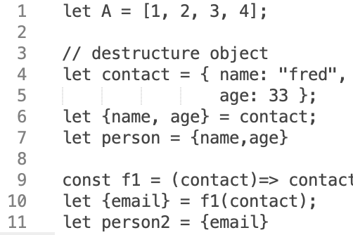


ECMA-262, 2020
Ecmascript
JavaScript
Syntax Tree
Parse it
Optimizing Compiler
Interpreter
Byte Code
Machine
Code

Slide 7
JavaScript Function Definitions
function f1(arg1, arg2){ ...do something and return } // Function Definition
const f1 = function (arg1, arg2){ ….do something and return } // Function Expression
const f1 = function f1(arg1, arg2){ ….do something and return }
const f1 = (arg1, arg2) => { … so something and return } // Fat Arrow
const f1 = (arg1, arg2) => ‘Hello” // does not need brackets and return is assumed if on one line
------------------------- example
const f1 = ()=>3

Slide 8

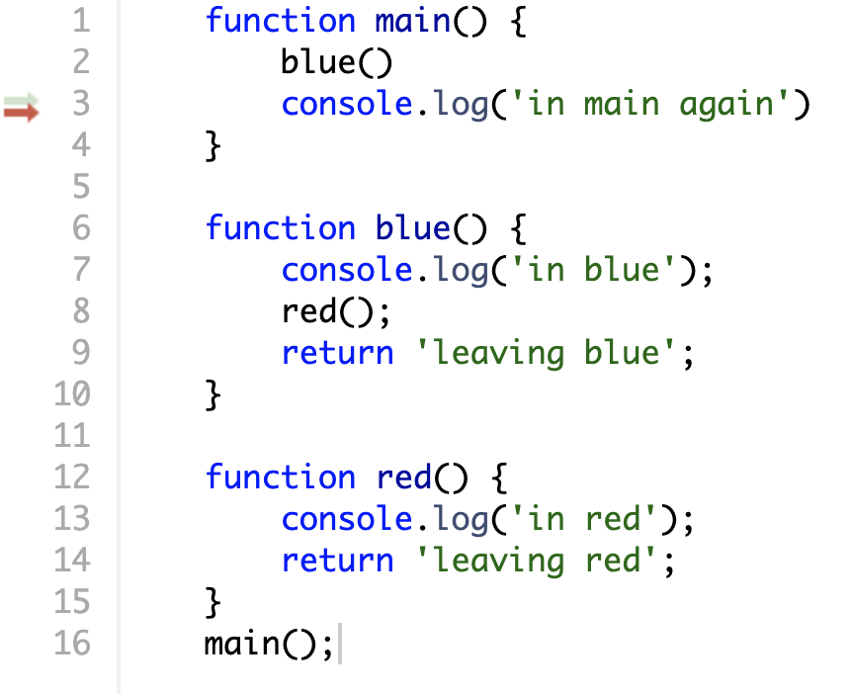
Computer
Memory
Machine Instructions

Slide 9
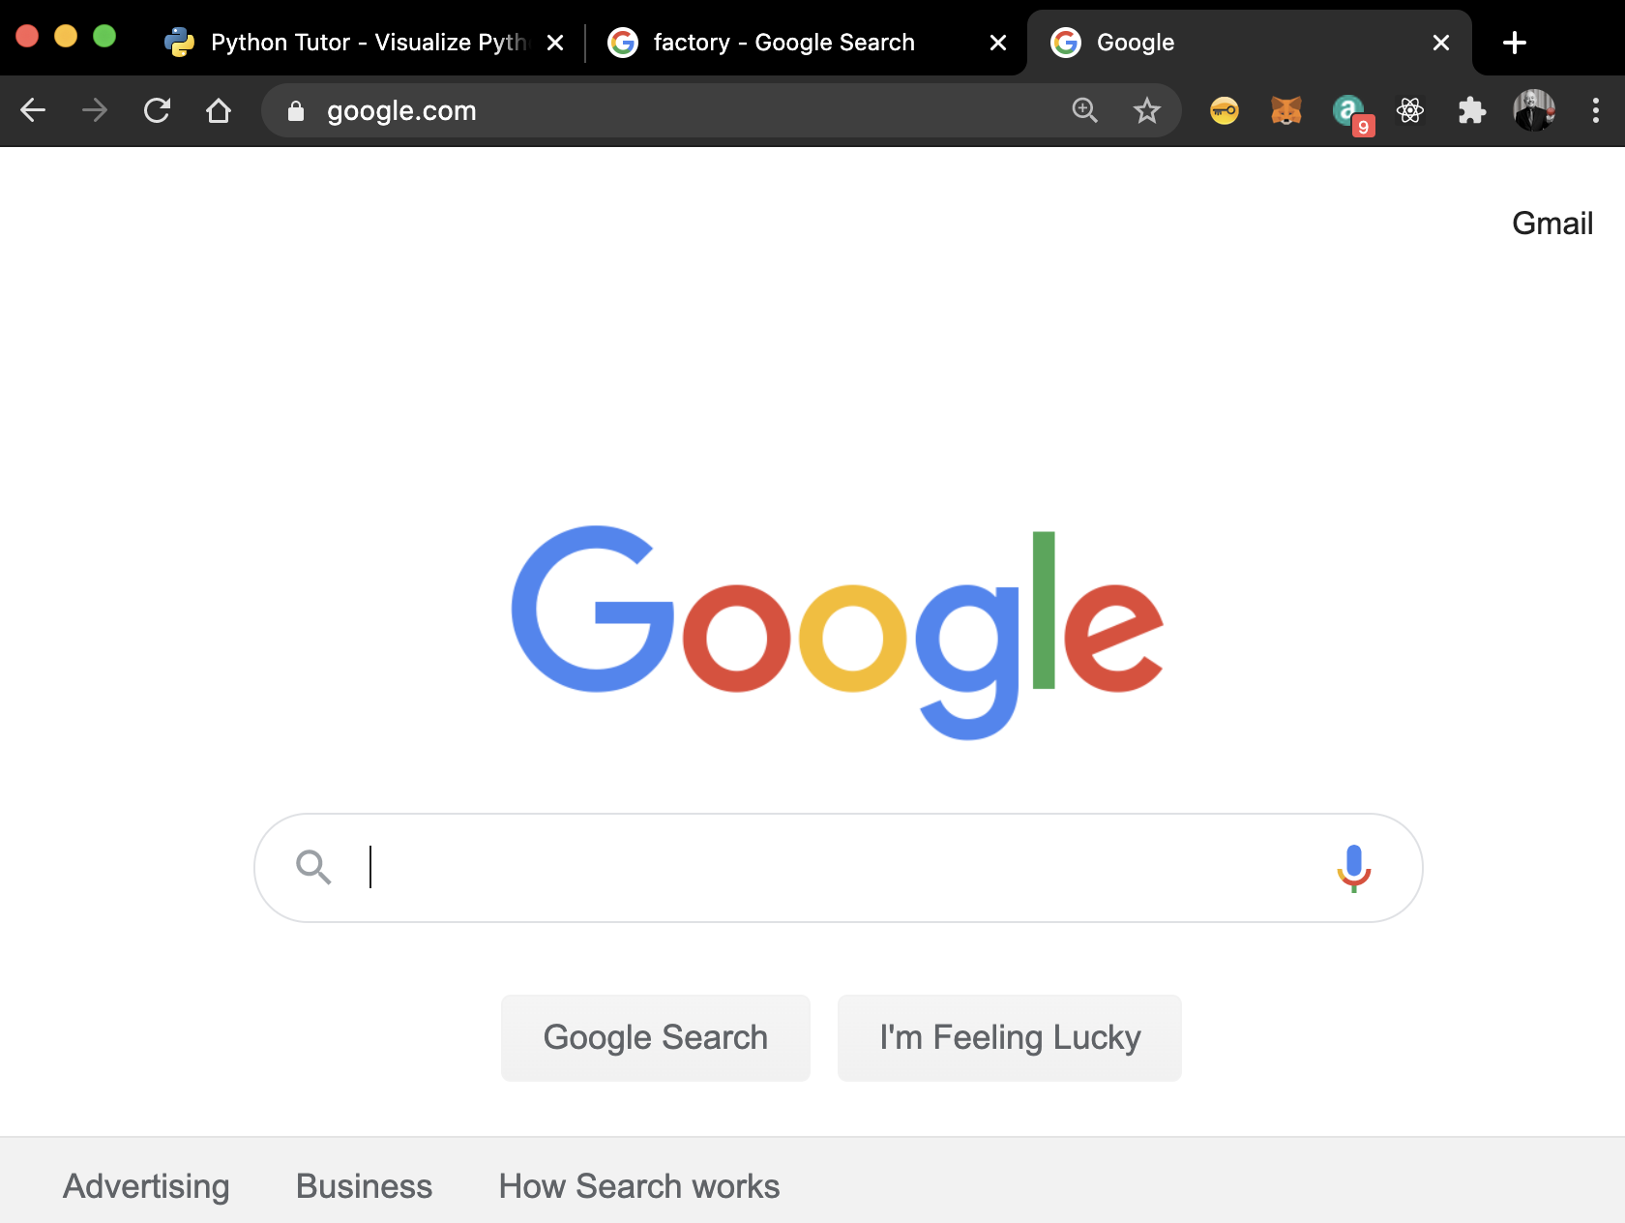
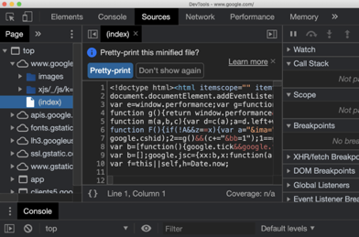
Memory
Computer
Heap
Stack
window stack
Machine Instructions

Slide 10



We Push and Pop
“frames” onto the Stack
function main(){
blue();
// return here from blue
}
function blue(){ red(); return; }
function red(){ … return;}
red()
blue()
main()

Slide 11
Exercise 3 - http://www.pythontutor.com/live.html#mode=edit
function main(x) {
x = x + blue(x);
return x;
}
function blue(x) {
x = x + red(x);
return x;
}
function red(x) {
x = x + "he";
return x;
}
let x = "say "
console.log(main(x))
What will get printed in the console?

